Slide 1
Web Development Project Presentation
Name: shivansh
Roll No: 24/SCA/BCA(AI&ML)/062
Guide: Ms. Iram Fatima
Institution: MRIIRS

Slide 2
Introduction
Good morning everyone. My name is shivansh, and today I’ll be presenting my web development project, created as part of my BCA curriculum .

Slide 3
Project Overview
Created:
- Calculator Web App
- Portfolio Website
Tech Used: HTML, CSS
I created three static websites: a calculator app, a landing page highlighting current issues in India, and a personal portfolio site. These were built using HTML, CSS, and JavaScript.

Slide 4
Objectives
Skill enhancement in Web Dev
Real-time project exposure
Internships and mentorship
Build portfolio & industry readiness
The main goal was to improve my web development skills, work on real projects, and build a personal portfolio that I can share with potential employers. The internship also gave me guidance from experienced mentors.

Slide 5
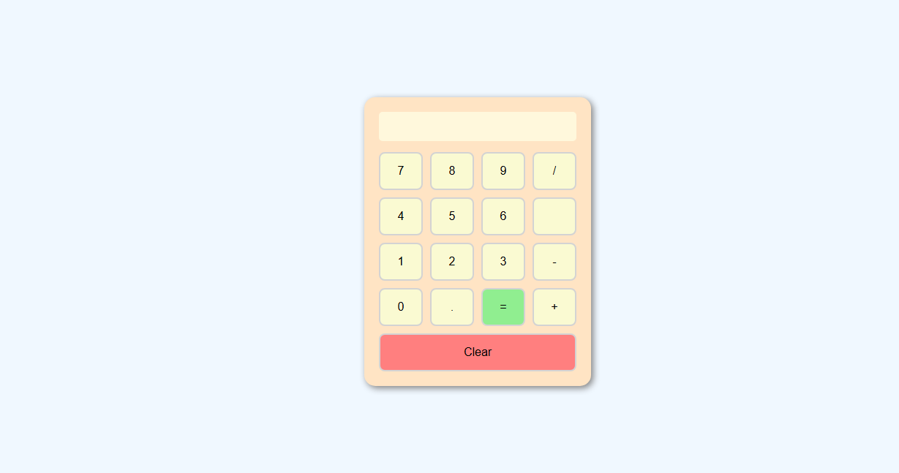
Existing System & Limitations
Static websites only, no backend
Hardcoded content, poor responsiveness
No accessibility features, basic UI

Slide 6
Proposed System Features
backend support (Node.js/Firebase)
Responsive UI (Bootstrap/Tailwind)
Secure logic (No eval())
Interactive UI + API integration
So I planned some improvements: adding backend functionality, using frameworks like Bootstrap for a modern look, making the UI more interactive, and adding features like API integration for real-time data.

Slide 7
Feasibility Study
Technical: Beginner-friendly tools
Behavioral: Clean UI, intuitive navigation
Economic: No cost, freelance potential
Technically, the tools used were easy and free to access, like VS Code and GitHub. The design is user-friendly, and there was no cost involved. In the future, the portfolio can even help me earn by attracting clients.

Slide 8
System Analysis

Slide 9
This is the most important takeaway that everyone has to remember.

